Slide 1
Map Reduce
Developed by Google

Slide 2
SQL: select count(1) from table => same with word count concept
Shuffle & Sort
5 node
4 node
System auto do that
User no feeling
Like SQL group by

Slide 3
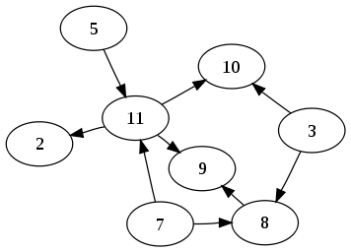
Map-Reduce
Hadoop always do Map-Shuffle-Reduce 3 stages
But shuffle has overhead about network and IO latency
Some operation don’t need to shuffle
For tuning performance
DAG (directed acyclic graph)
a directed graph with no directed cycles

Slide 4
DAG
Divide Map and Reduce action to sub-action
Below image, white means mapper, green means reduce
No DAG
With DAG

Slide 5
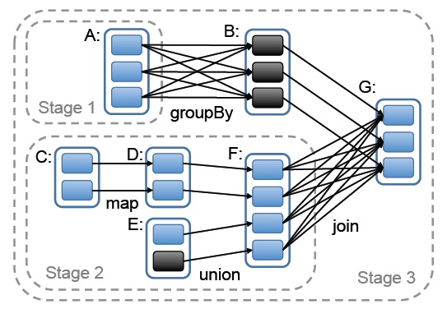
DAG
Each stage stands for one node

Slide 6
From WordCount, We can…
Min
Max
Average
Standard Deviation

Slide 7
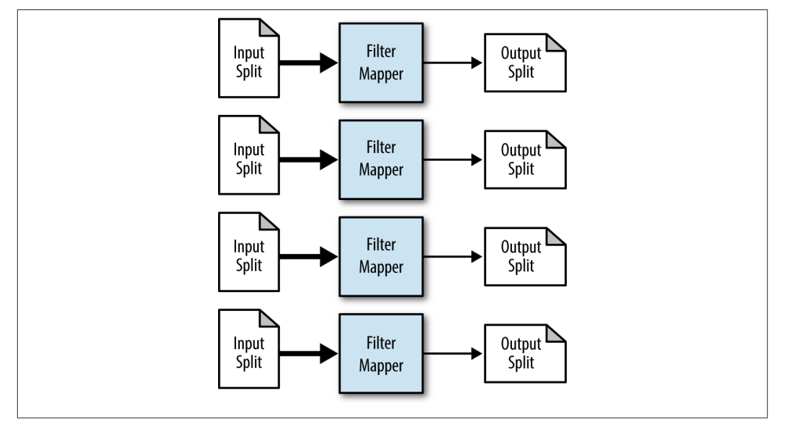
Filter
Select * from table where value < ?
Select distinct(*) from table

Slide 8
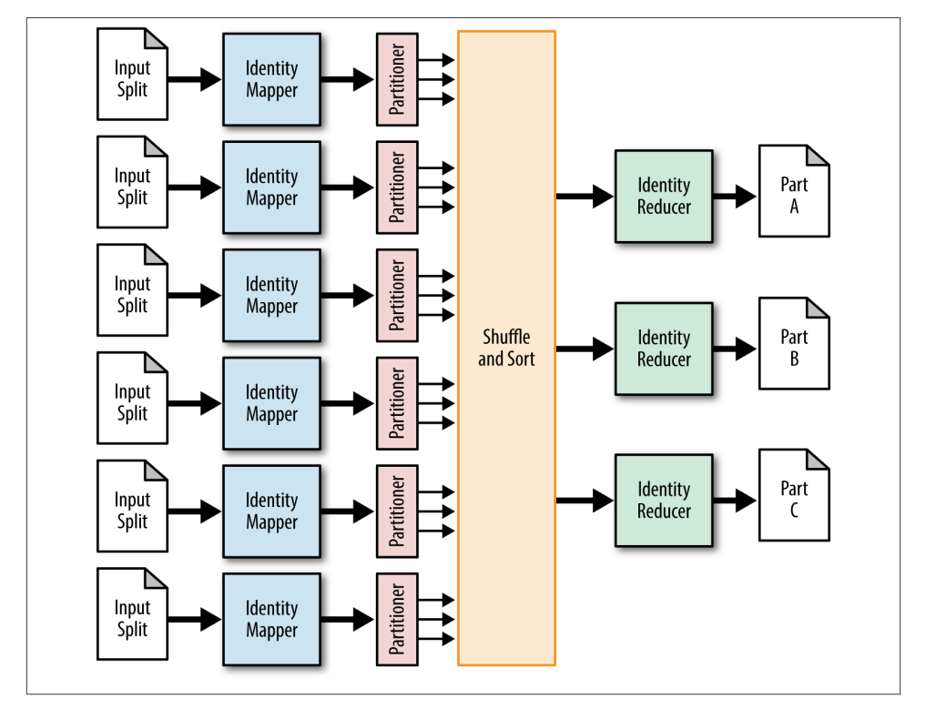
Partitioner
You can define many partitioners than actual node, some algorithm may need it to manual decide the number of mapper

Slide 9
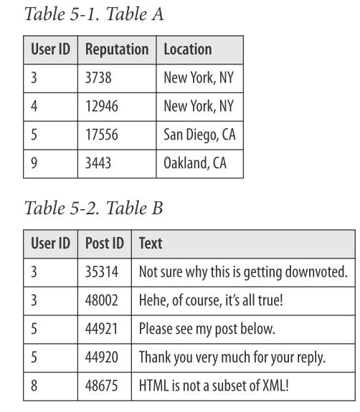
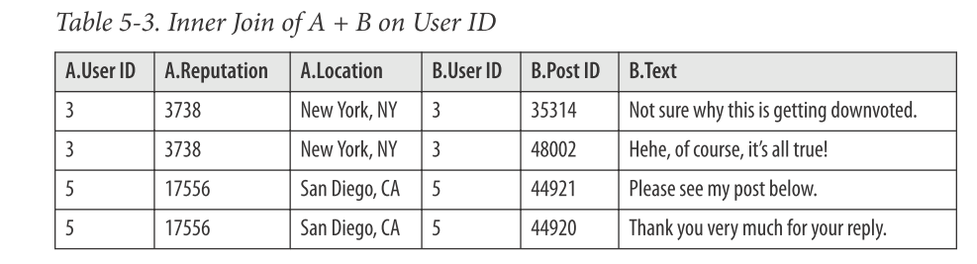
Join
Inner Join
Outer Join
Left Join
Right Join
Need to do shuffle
Select A.UserId, A.Reputation, B.UserId, B.PostId, B.Text from A Inner Join B on A.UserId = B.UserId

Slide 10
Spark API
https://spark.apache.org/docs/latest/api/java/org/apache/spark/api/java/JavaRDD.html
https://spark.apache.org/docs/latest/api/java/org/apache/spark/api/java/JavaPairRDD.html
Just show API name

Slide 11
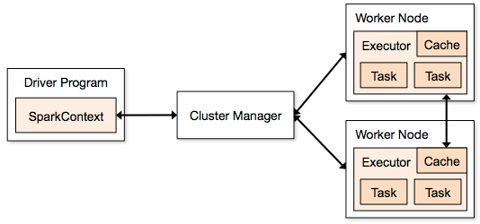
System execute MR
Client side execute the main program: means Driver Program
The MR program should deploy to all worker node to let node execute MR code

Slide 12
Thanks for your attention
Demo

